Slide 1

Job Change of Data Scientists
Connor Love

Slide 2
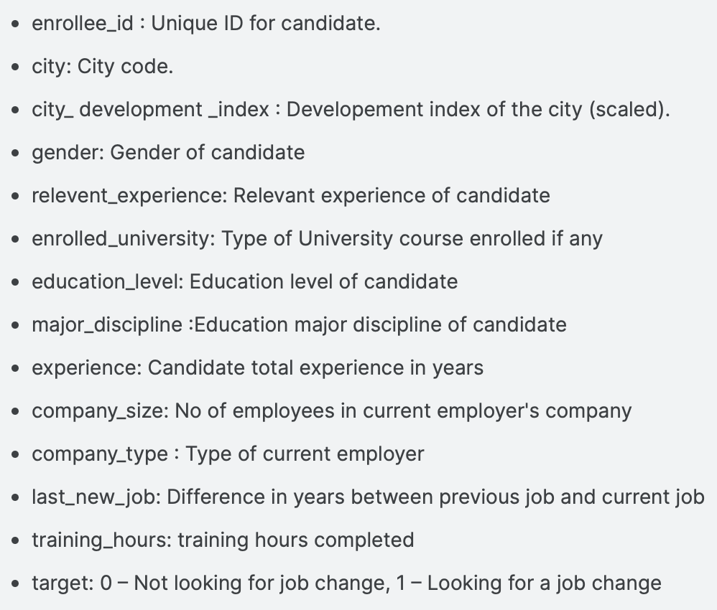
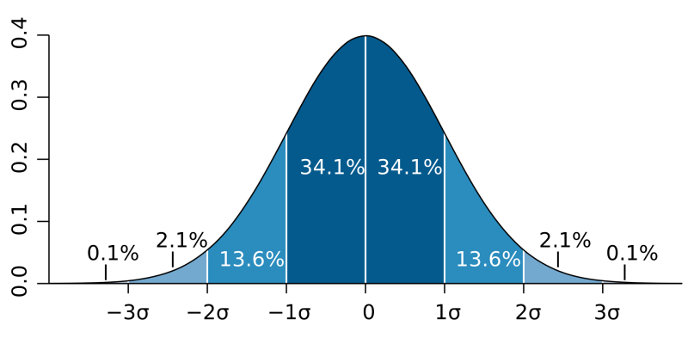
overview
(Source: Kaggle)
The Data:
Looking for a job?
14 features
Hypothesis:
Correlation is “why”
Null = No difference Seeking ←→ Non-seeking
Distribution = 66.6% Seeking ←→ 33.4% Non-seeking... beat 50%, 66%, 70%
(Source: Management and Strategy Institute)

Slide 3
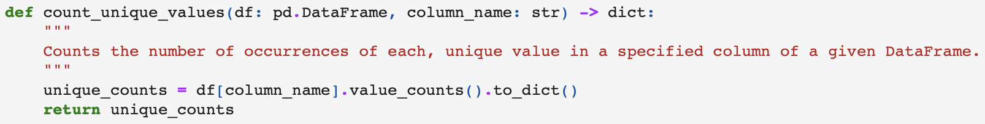


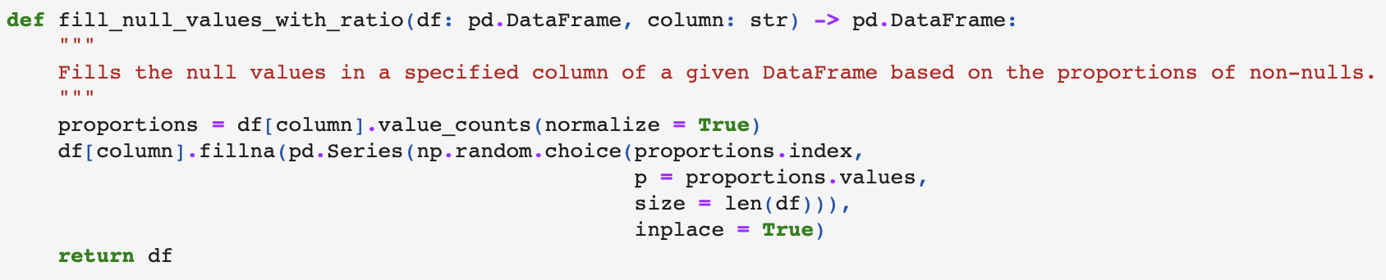



Handling nulls
Male: 13221/14650 = 90.2%
Female: 1238/14650 = 8.5%
Other: 191/14650 = 1.3%
Male: 13221/19158 = 90.1%
Female: 1655/19158 = 8.6%
Other: 245/19158 = 1.3%

Slide 4
ENCODING
Ignored:
Enrollee ID (confounding)
City Development Index (all integers from 0 to 1)
Training Hours (all integers)
Target (all either 0 or 1)
Label-Encoded (No order):
City
Gender
Enrolled in University (Part-time, Full-time)
Major / Discipline
Company Type
Mapped (Order):
Relevant Experience (None, Has)
Education Level (Primary, HS, Graduate, Master’s, PhD)
Experience (years at current)
Company Size (# employees)
Last New Job (years since)

Slide 5
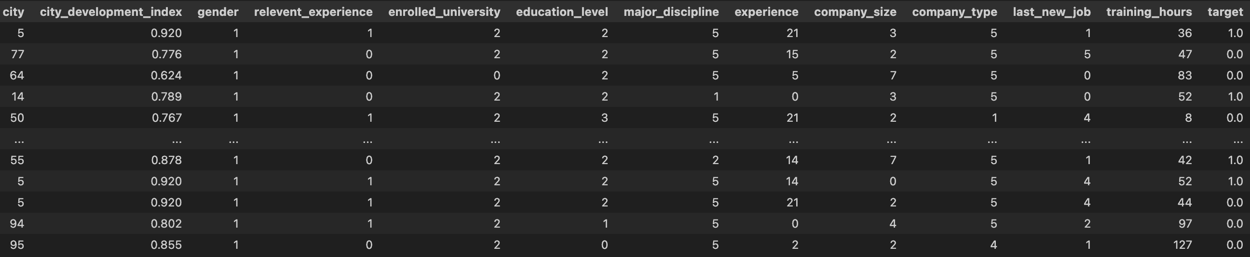

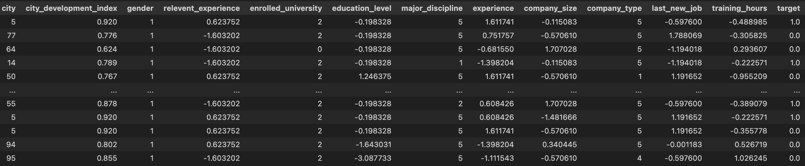
normalization
LE
LE
LE
LE
LE

Slide 6
typos
'city_development_index’ 'city_dev_index’
'relevent_experience’ 'has_relevant_exp’
’last_new_job’ 'yrs_since_last_job’
'education_level’ 'degree_lvl’
'enrolled_university’ 'in_school’
'experience’ 'yrs_exp’
'enrollee_id’ 'id’
Clarity
Simplification

Slide 7
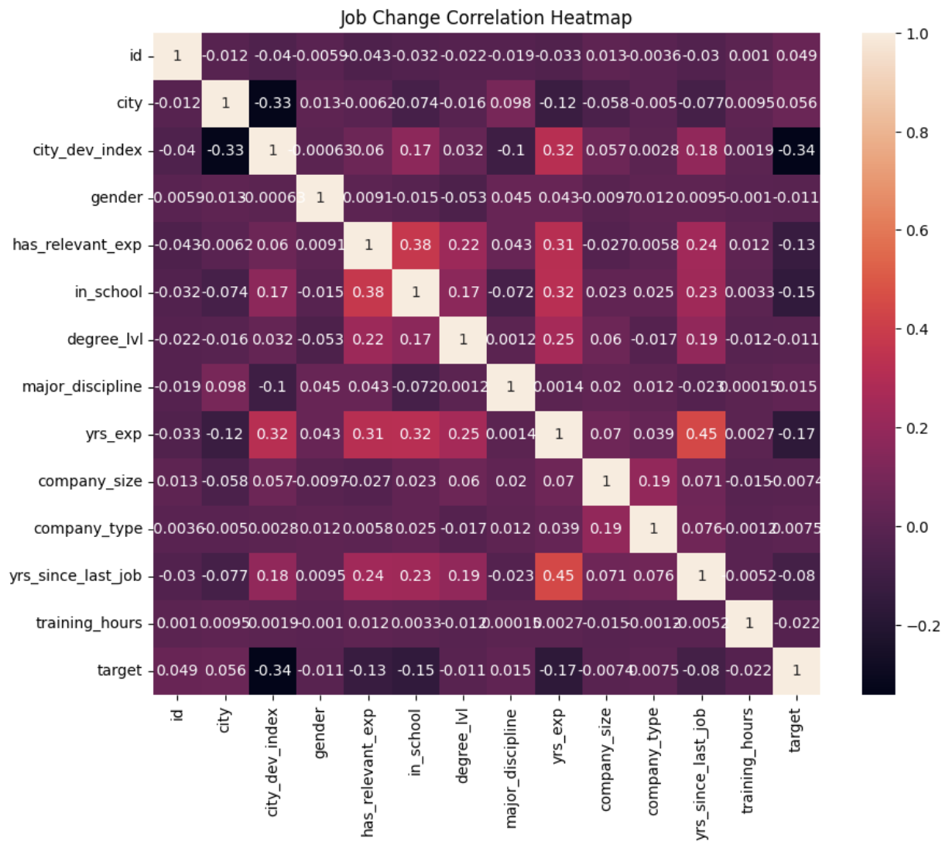
feature selection
City Development Index = -0.34
Has Relevant Experience = -0.13
In School = -0.15
Years of Experience = -0.17
Years Since Last Job = -0.08
0.45 correlation with Years of Experience
Cutoff (overfitting)

Slide 8
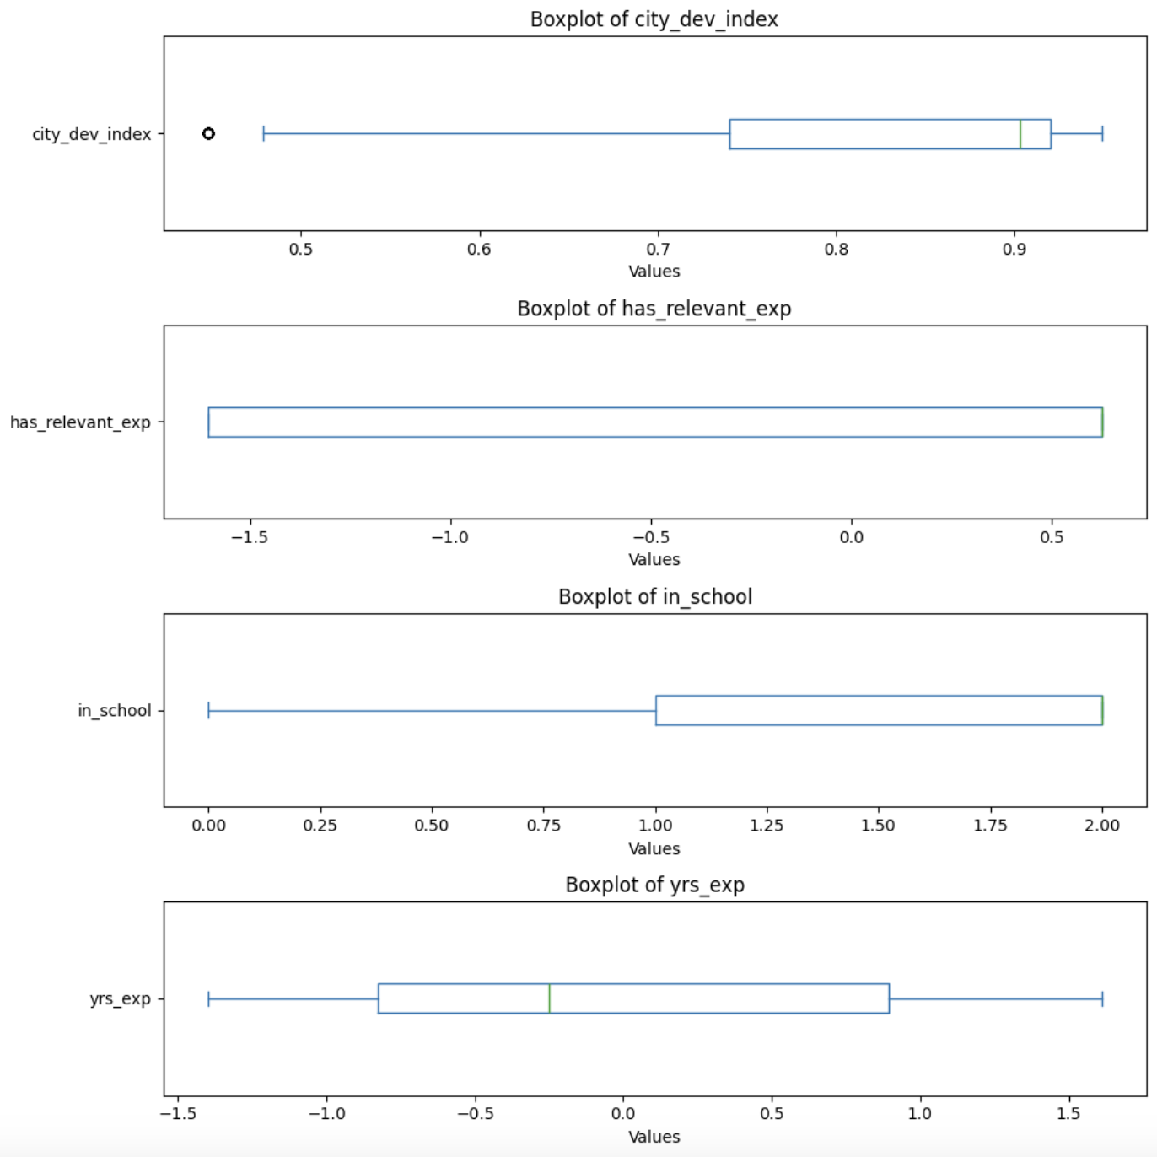
feature balance
Negative skew, healthy IQ/outlier range, more harm than good
No stratification
Strong negative skew, strange ranges, high imbalance bimodal?
Investigate further
Strong negative skew, strange ranges, mild imbalance bimodal?
Investigate further
Slight positive skew, healthy IQ/outlier ranges, gaussian shape…
No stratification

Slide 9
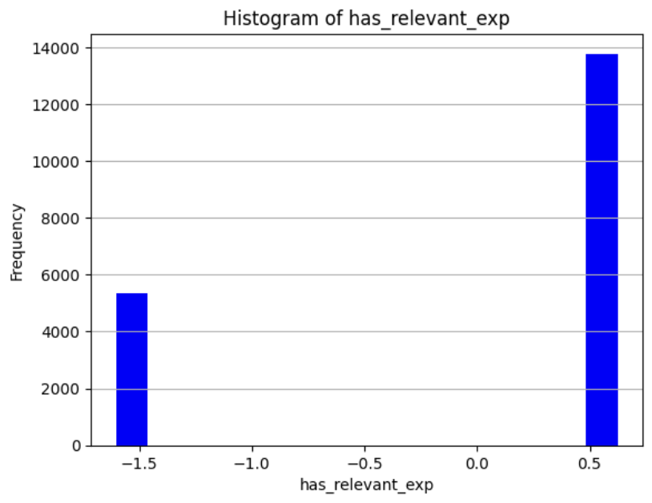
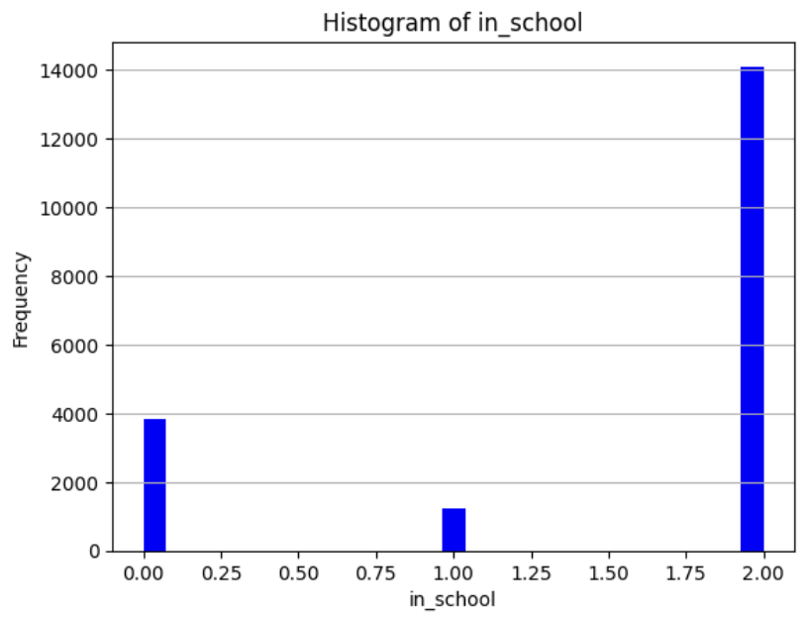
feature imbalance
versus…
No Relevant Experience : Has Relevant Experience
~5,100+ : ~13,800 = Balanced enough
Simplify, simplify
Full-time : Part-time : Not Enrolled
~3,800 : ~1,100 : ~14,000
Investigate further

Slide 10
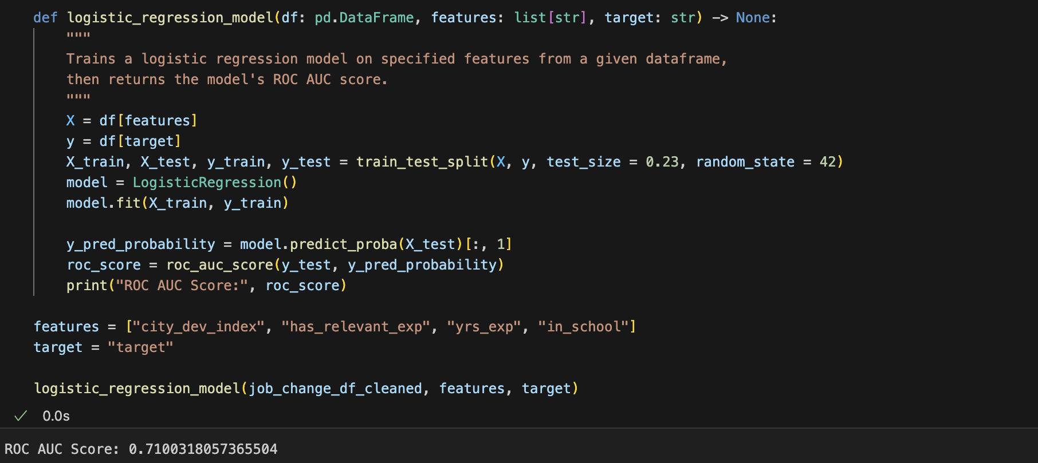
MODEL 1A — Unstratified log
71 ROC AUC (good metric), reject null
Tuned to test size and random state of stratified (“control model”)
We can do better… naïve approach

Slide 11
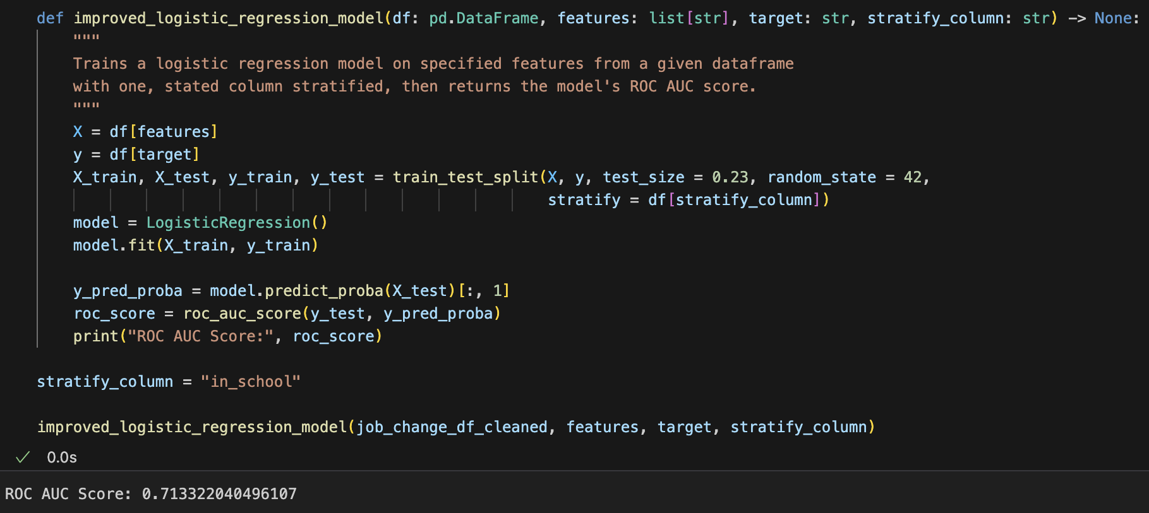
MODEL 1B — stratified log
+0.3% ROC for THIS random state, THIS test size… alternates
Potential overfitting
More harm than good for less imbalanced features

Slide 12
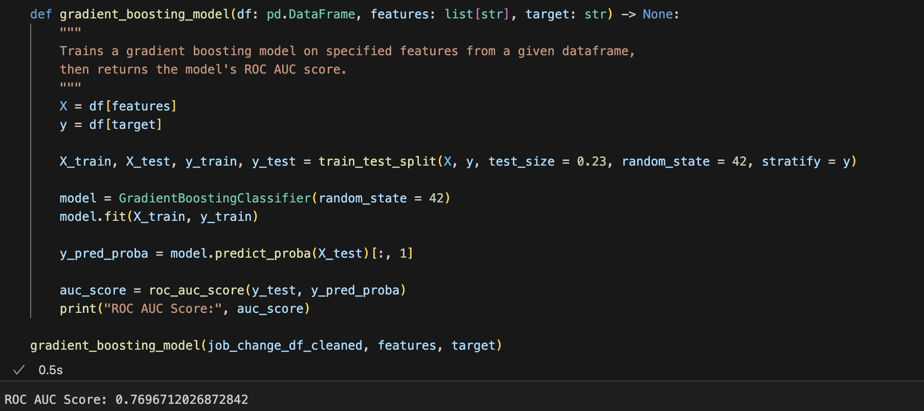
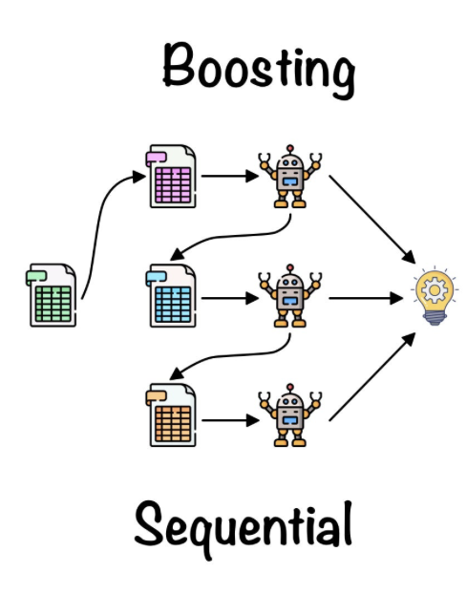
MODEL 2 — Ensemble learning
+6% ROC for SAME random state and test size
Pattern exists

Slide 13

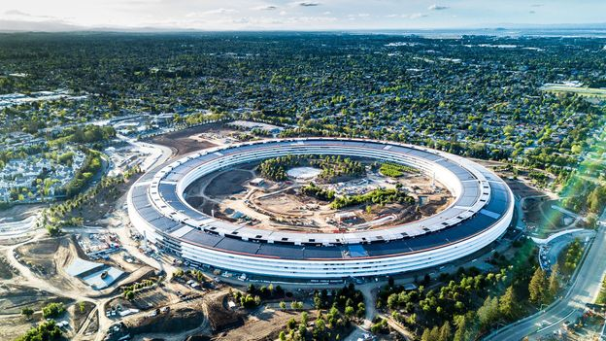

FINDINGS
ANOVA would be better… but similar results across other projects… reject null!
City Development (-0.34) most standout predictor:
Intuitive correlation
Less intuitive weight vs other features, but hopeful
(Source: The Assembly NC)
(Source: BBC)
(Source: Wikipedia)

